Slide 1


Primary and Secondary Sources

Slide 2
How Do We Know?
Who or what do you love to learn about, from the past?
  Queens and Kings?
  Dinosaurs?
  Athletes?
  Musicians and Artists?
  Authors?
How do we learn about it?
Where does the information come from?

Slide 3
Sources!
A source is a thing that gives us information. Some sources are objects, like bones or teapots. Diaries and books are sources. Other sources are images, like paintings and photos or recordings.
Even people can be sources! A teacher can be a source. A person who was present at the time of an event is a source. A person who knew a specific person is a source.
Let’s explore different kinds of sources.

Slide 4
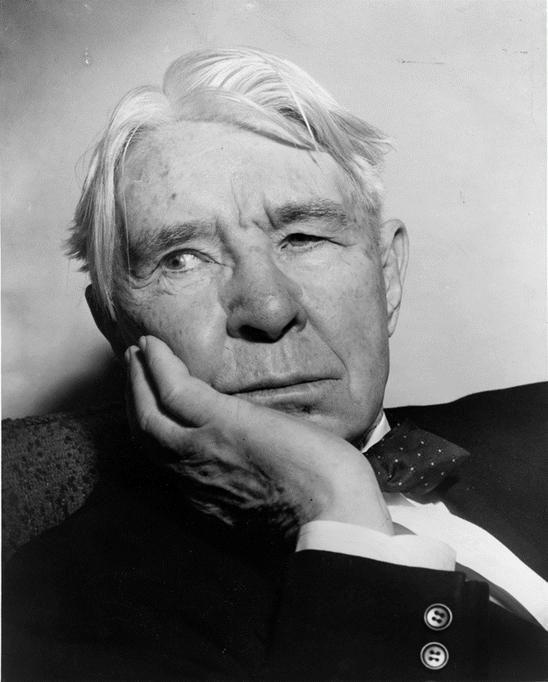
Have you ever heard of Carl Sandburg?

Slide 5
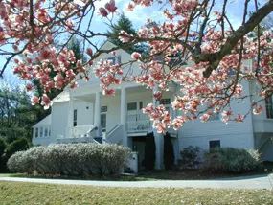
Carl Sandburg was…
An American Poet
A Journalist
A Biographer
An Editor
A Pulitzer Prize Winner
And a long-time resident of Connemara in Flat Rock, North Carolina.

Slide 6
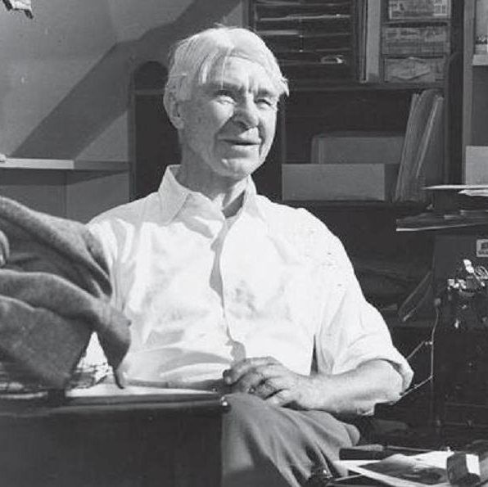
What Can We Do to Learn More About Him?
Go to the sources!
This photograph tells us what Carl Sandburg looked like. It was taken when Mr. Sandburg was still alive and in person. This kind of source is a primary source.

Slide 7
Primary Sources
Primary sources are original objects or documents. These sources are as close as possible to the original person, event, or time period.
An poem by Mr. Sandburg and read by Mr. Sandburg is a primary source. Let’s check one out!
“Fog” – Poem by Carl Sandburg

Slide 8
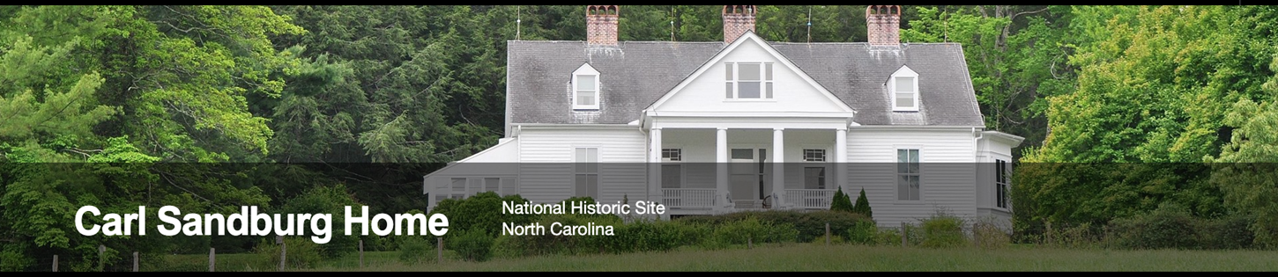
Where Else Can We Look?
Today, the home of Carl Sandburg, Connemara is a National Historic Site.
The website provides timelines and biographies, these are secondary sources.

Slide 9
Secondary Sources
A secondary source is not original. It gives information but is not first-hand evidence. A secondary source draw on other sources.
Secondary sources can be books, images, art, and more. They use other sources, like primary sources, to collect information.

Slide 10
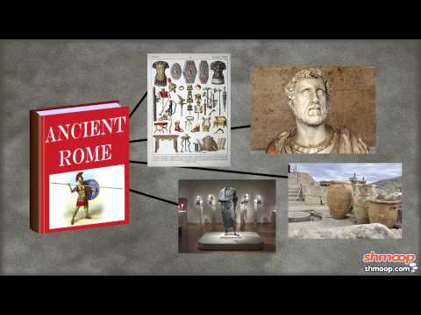
Video Break!

Slide 11
Now Can You Tell the Difference?
Let’s practice looking at a few sources about the history of Connemara in Flat Rock, North Carolina.
Examine each source, decide the source type (primary or secondary) and write down at least three observations about the source. Consider…
  What is the source?
  When was it made?
  What is the subject of the source?
  What does the source tell you about history?
Based on your observations and what you have learned about sources, decide if the source is primary or secondary.

Slide 12
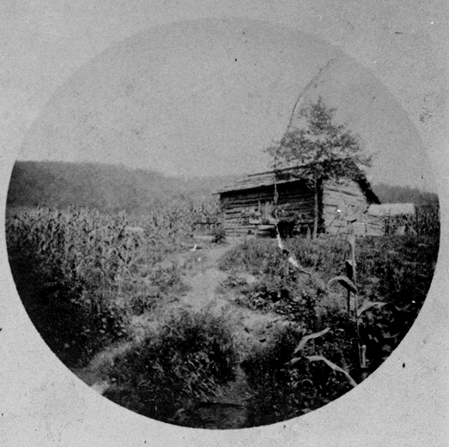
Dwelling of an Enslaved Person
Housing for enslaved persons during the Memminger ownership of the property [Connemara], when it was known as Rock Hill. Dated 1888.

Slide 13
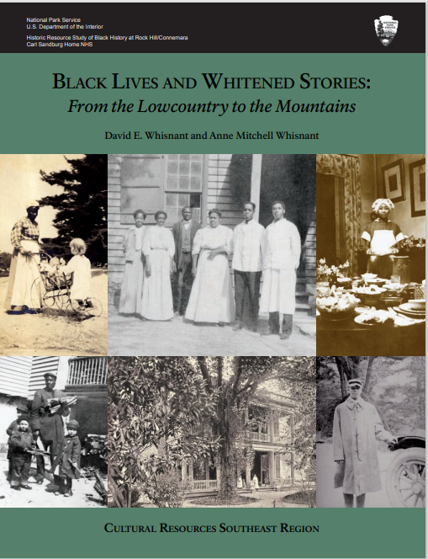
A Recent Book from the Carl Sandburg Home National Historic Site.
Black Lives and Whitened Stories: From the Lowcountry to the Mountains. A recent historic resource study, published in 2020. The authors look at multiple histories written about Connemara, Flat Rock and western North Carolina.

Slide 14

James Fisher Interview 1975
James Fisher: I came to Mr. Captain Smyth in the middle of the year 1911 or 1912. I was sent from Greenville, South Carolina, by his daughter, Mrs. Margaret McKissick. My mother was a cook for her. She sent me up to Greenville to work for her mother and father in Greenville. Right out of school, I came right out of school to Captain Smyth (in Greenville).
Interviewer: So you went right out of school to Captain Smyth?
James Fisher: Captain Smyth, his daughter, put that down. His daughter Mrs. Margaret McKissick, sent me up to Greenville to work for her mother and father (Captain Smyth), ‘cause my mother was her cook.
Interviewer: Alright now you say there were seven servants here in the house?
James Fisher: Yes, in Greenville. Yes, we had seven servants.
Interviewer: Alright. How many did you have here (Connemara)?
James Fisher: Well, they all came up here and...
Interviewer: They all came up here?
James Fisher: And that was horse and buggy days too you know. I can name them to you. There was Paul, the coachman, George was Captain Smyth’s chauffer, Plummer was the cook, me as the butler, that’s four. Me, the butler, and then they had the laundry work was done on the place, that was Ludy, she was the laundress, that’s five. And then we had old man Robert, he was the flower man, worked out in the yard. Six, seven, one more. Anyway, seven servants.
Interviewer: And they all came up here?
James Fisher: Oh and then after I, after they let Jim Robinson go back, well when the chauffer old George had to go to Greenville to work together, then I had to take over as chauffer.

Slide 15
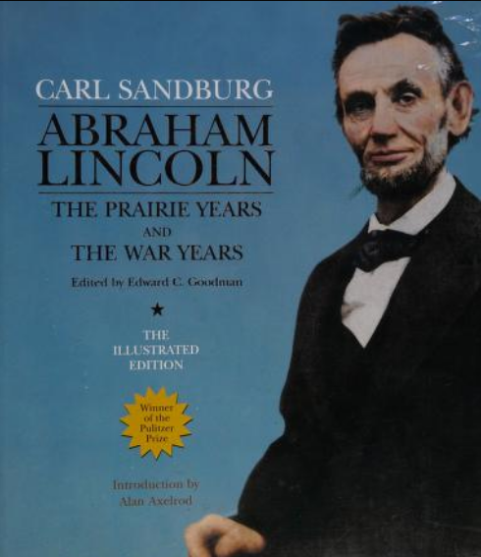
Abraham Lincoln Biography by Carl Sandburg
This biography was originally published in 1954, written by Carl Sandburg.
This source can be tricky!
If you are researching Abraham Lincoln, is it a primary or secondary source?
If you are researching Carl Sandburg, is it a primary or secondary source?

Slide 16
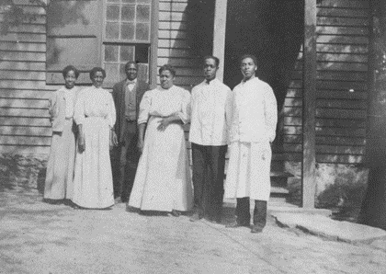
Servants at Connemara
Photograph of unidentified employees during the Smyth ownership of the property, circa 1910, in front of the detached kitchen (later the Sandburg family garage).

Slide 17
Exit Ticket
Aha!
Huh?
Using complete sentences, write down two new things you learned about today.
Using complete sentences, write down two knew things we learned about today that you still have questions about.

Slide 18
Lesson Biography in Order of Appearance
Photograph. “Carl Sandburg, head-and-shoulders portrait, facing left.” World-Telegram and Sun photo. Al Ravenna. 1955. Library of Congress.
Photograph. “History of Connemara: Sandburg Era.” Carl Sandburg Home National Historic Site. NPS. Oct, 2021. History of Connemara - Carl Sandburg Home National Historic Site (U.S. National Park Service) (nps.gov)
Photograph. “Carl Sandburg Home: People” Carl Sandburg Home NHS. NPS. Oct, 2021. People - Carl Sandburg Home National Historic Site (U.S. National Park Service) (nps.gov)
Carl Sandburg Home NHS. NPS. April, 2023. Carl Sandburg Home National Historic Site (U.S. National Park Service) (nps.gov)
“What is a Primary Source? By Shmoop.” YouTube. 2015. (193) What is a Primary Source? by Shmoop - YouTube
“Slave Dwelling.” From the Ballard Family Photograph Collection at Carl Sandburg Home NHS. NPS. Gallery Item Display (nps.gov)
Anne Whisnant and David Whisnant. Black Lives and Whitened Stories: From the Lowcountry to the Mountains. Carl Sandburg Home NHS. NPS. 2020.
James Fisher Interview. 1975. NPS. Black History at Rock Hill/Connemara (U.S. National Park Service) (nps.gov)
Carl Sandburg. Abraham Lincoln: The Prairie Years and the War Years. New York: Sterling. 2007. Internet Archive.
“Smyth Servants.” Photograph. Circa 1910. From the J.W. Haynie Photograph Collection at Carl Sandburg Home NHS. NPS. Gallery Item Display (nps.gov)

Slide 19
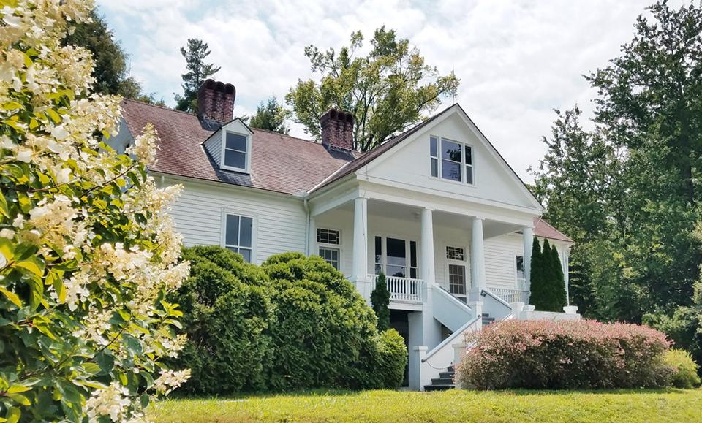
Connemara STEM Challenge
Challenge: Design and build your own Connemara (a house)
Constraints:
Your house must have a perimeter of 42 inches.
Your house must be at least 18 inches tall
Use only the materials provided

